Slide 1
Ansible
Venkat Gurumoorthi

Slide 2
Agenda
Self Introduction
What is DevOps? & Why we need it?
Software Development
Waterfall
Agile
IT Operations
Introduction to DevOps
Ansible

Slide 3
Introduction
Name: Venkateswaran Gurumoorthi
Qualification: MBA
Technology: WebLogic, WebSpehere Admin and DevOps Engineer
Years of experience in DXC: 14
Total years of experience: 17
Reach me out: 735891 / vgurumoorthi@dxc.com

Slide 4
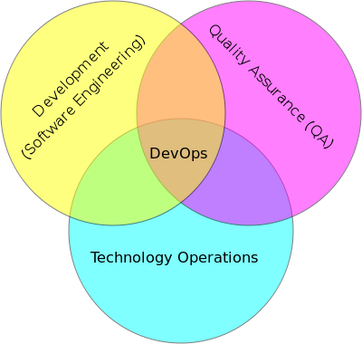
What is DevOps?
DevOps is an enterprise capability for Continuous Software Delivery
DevOps is an integrated coupling of Process, Infrastructure, and Product
DevOps is the productive intersection of Cross Team Cooperation
DEVOPS emphasizes:
Flexibility
Agility
Automation
Collaboration
Communication
Cross-team cooperation
Ownership
The walls separating development, QA, and production are barriers to agility. DevOps breaks down these walls. DevOps is a new culture and process where Development, QA, and Operations work together to expedite development and problem resolution.

Slide 5
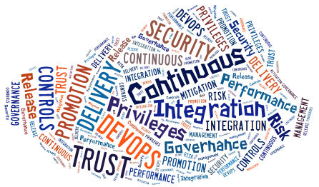
Why DevOps?
Drivers
Benefits
Reduced deployment and operational outage times
Reduction of human-in-the-loop errors
Pressure to deliver higher quality applications faster
Expedited deployment process using increased automation (i.e. deployment, configuration, testing (less time, less manual effort))
Increased collaboration among departments (i.e. Dev, QA, Operations)
Improvement in quality of applications deployed, time-to-market speed
Reduction in spend on deployment operations caused by human-in-the-loop
Reduced IT cycle time

Slide 6
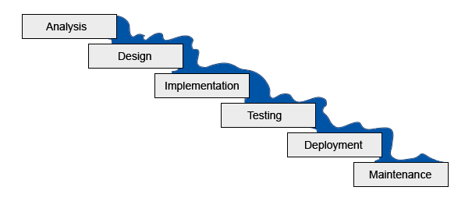
Waterfall

Slide 7
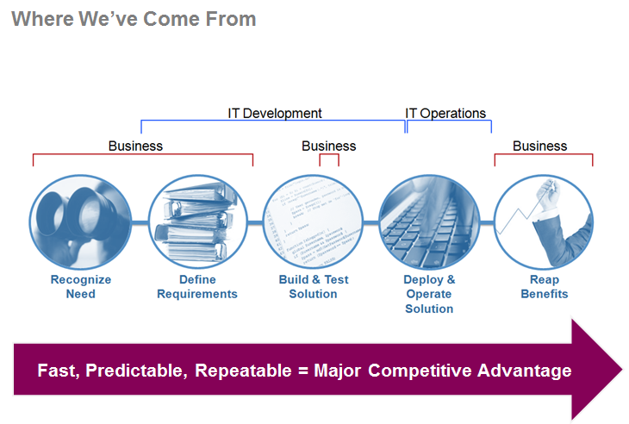

Slide 8
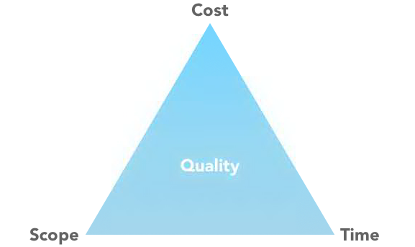
Triple constraints

Slide 9
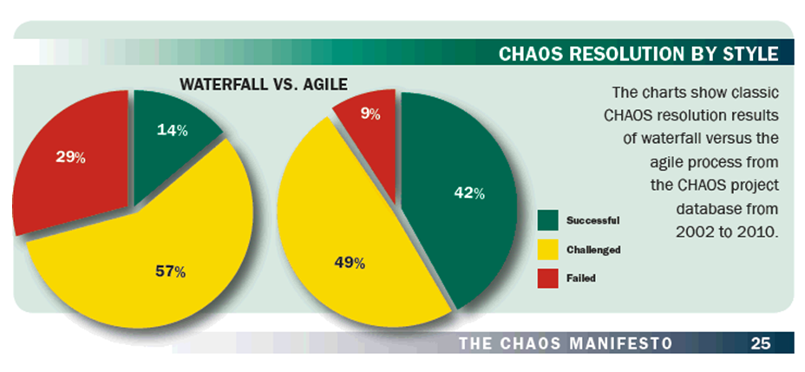
Agile

Slide 10
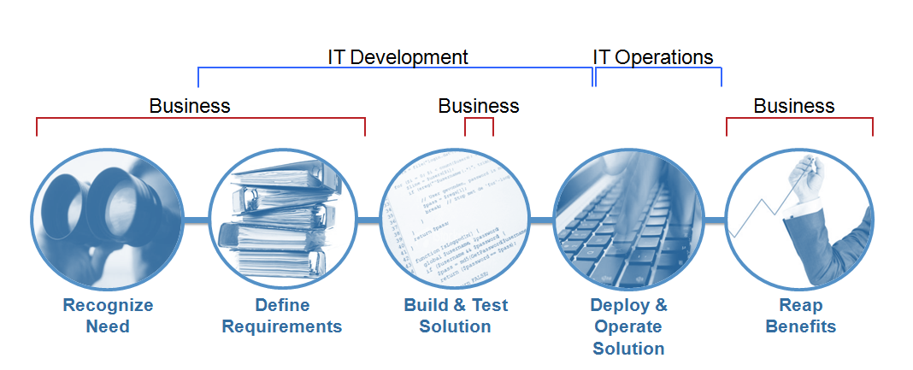
Agile Accelerating Development
Scope of Agile Methods

Slide 11
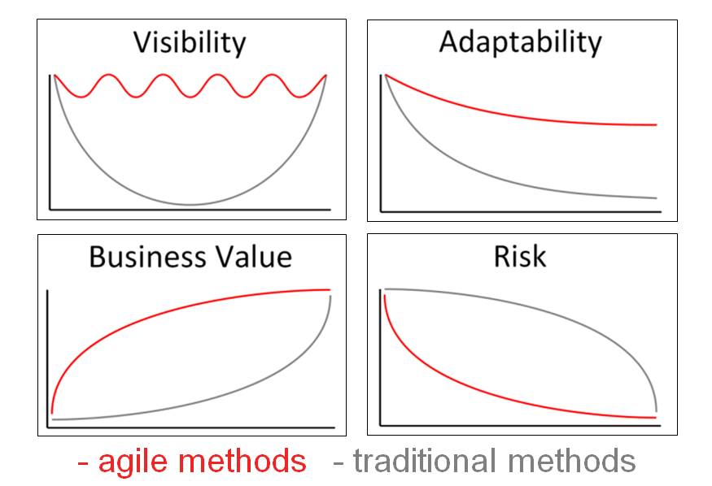
Benefits of Agile

Slide 12
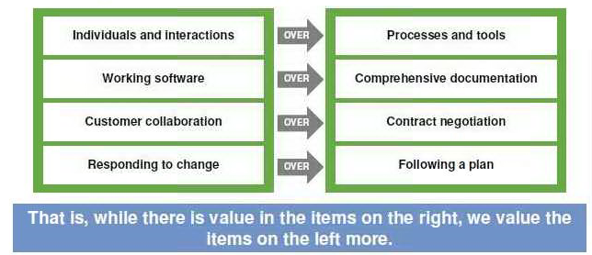
Agile Values and Principles

Slide 13
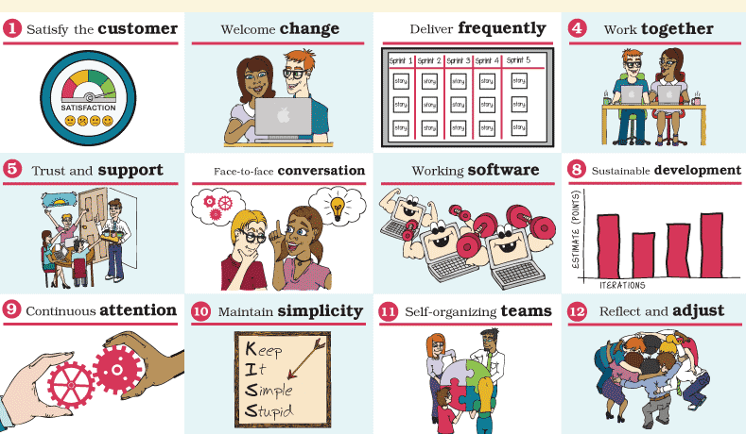
Agile Principles

Slide 14
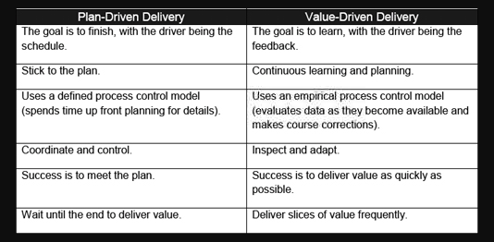
Waterfall vs Agile

Slide 15
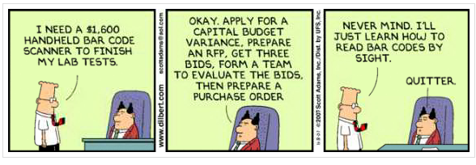
Planned Process Control

Slide 16
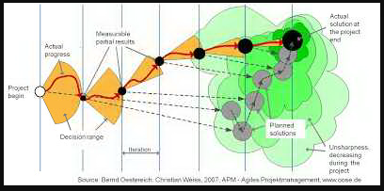
Empirical Process Control

Slide 17
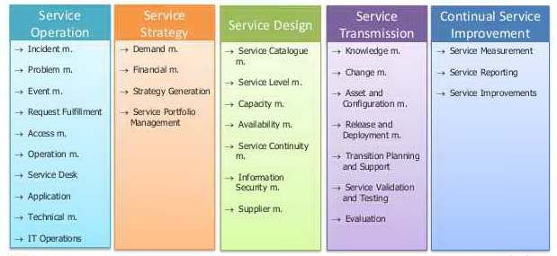
Service / Operations

Slide 18
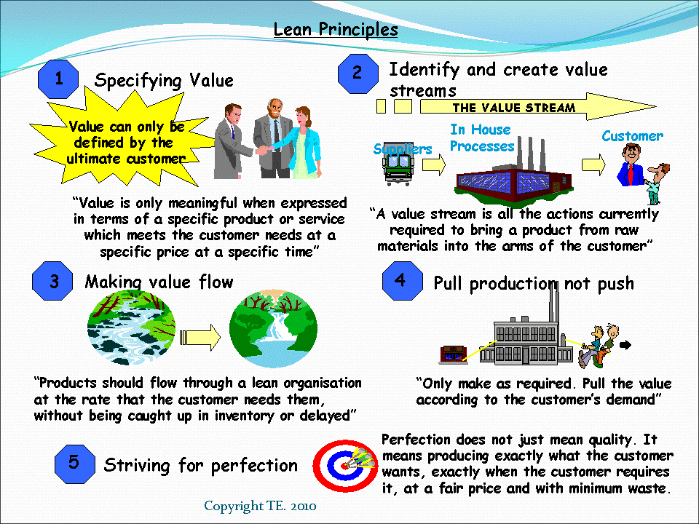
Lean Principles

Slide 19
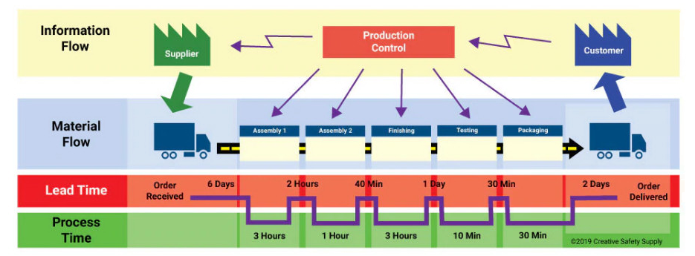
Value Stream Mapping

Slide 20
DevOps
Introduction to DevOps
DevOps capabilities
Adopting DevOps

Slide 21

Agile Fixes Only Part of the Story
Still a problem

Slide 22
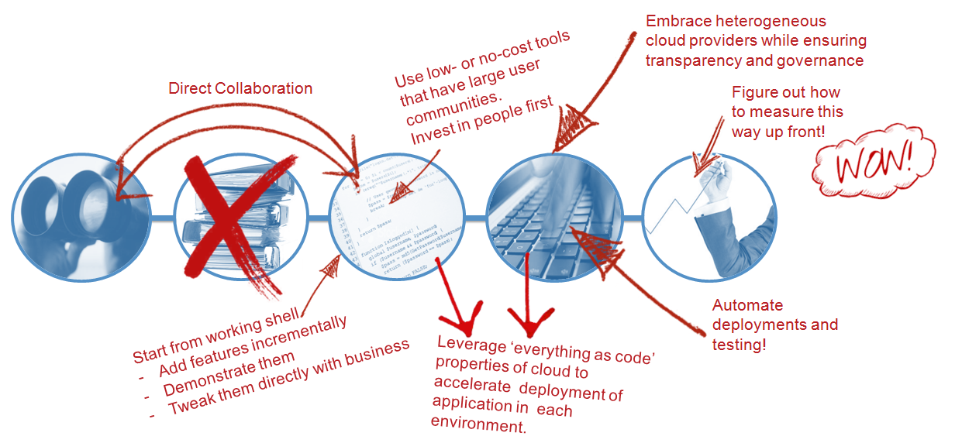

Our Value Chain Is Long and Full of Friction
LET’S DITCH THE FRICTION

Slide 23
Introduction to DevOps
Understanding the business need for DevOps
Systems of Record
Systems of Engagement
Recognizing the business value of DevOps
Enhanced customer experience
Increased capacity to Innovate
Faster Time to Value
How DevOps works (DevOps Principles)
Develop and test against product like systems
Deploy with repeatable, reliable processes
Monitor and validate operational quality
Amplify feedback loops

Slide 24
DevOps Principles
Develop and test against production like systems
Deploy with repeatable, reliable processes
Monitor and validate operational quality
Amplify feedback loops

Slide 25
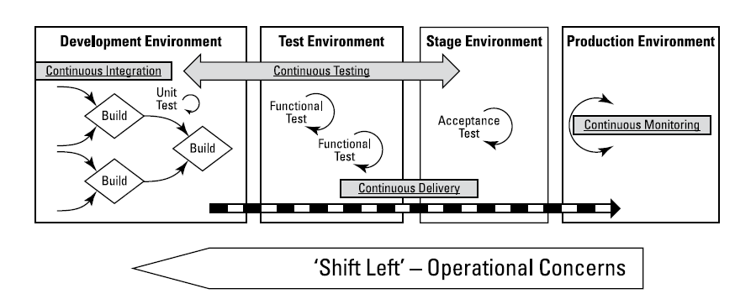
Develop and test against production like systems

Slide 26
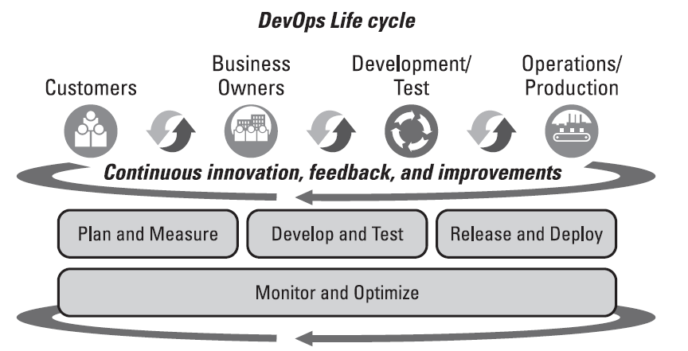
DevOps Capabilities

Slide 27
Paths to DevOps adoption
Plan and Measure
Develop and test
Collaborative development
Continuous testing
Release and Deploy
Monitor and optimize
Continuous monitoring
Continuous customer feedback and optimization

Slide 28
Plan and measure
Continuous business planning
To be agile and react quickly to customer feedback
Lean thinking techniques
Starting small
Eliminate waste

Slide 29
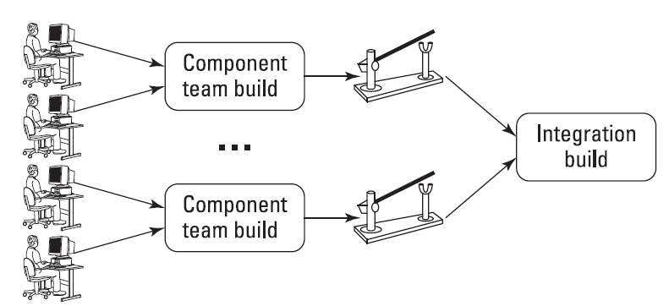
Develop and test
Collaborative Development
Continuous testing

Slide 30
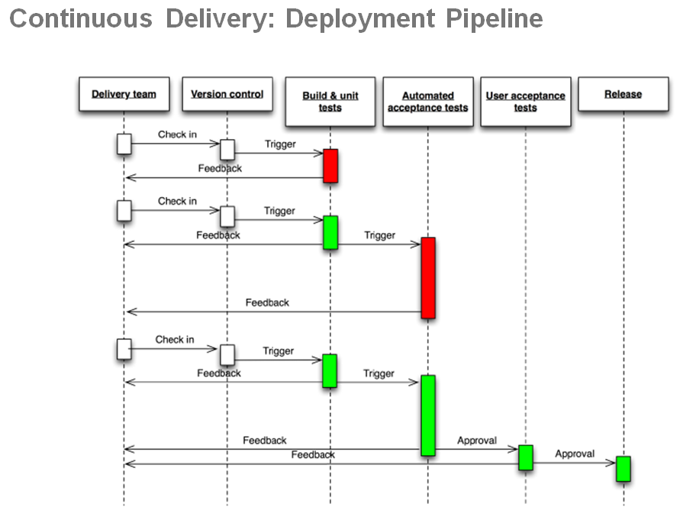
Continuous Delivery

Slide 31
Monitor and Optimize
Continuous Monitoring
Continuous customer feedback and optimization

Slide 32
Adopting DevOps
People
Culture
Identifying business objectives
Environment of sharing
DevOps teams
Process
Business process
Change Management process
DevOps practices
Technology
Infrastructure as a code
Delivery pipeline
Deployment automation and release management

Slide 33


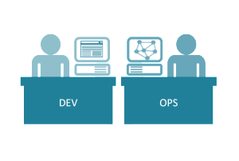



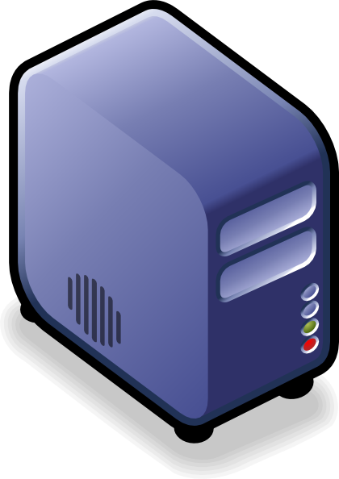
DevOps Practices
Continuous Delivery
Continuous Integration
Continuous Testing
Continuous Deployment
DEV
OPS
Continuous Provisioning
Renewal of the relationship, processes and governance models between development (Dev) and IT Operations (Ops) stressing communication, collaboration, transparency and automation with a view to more rapidly deploying high quality application releases

Slide 34
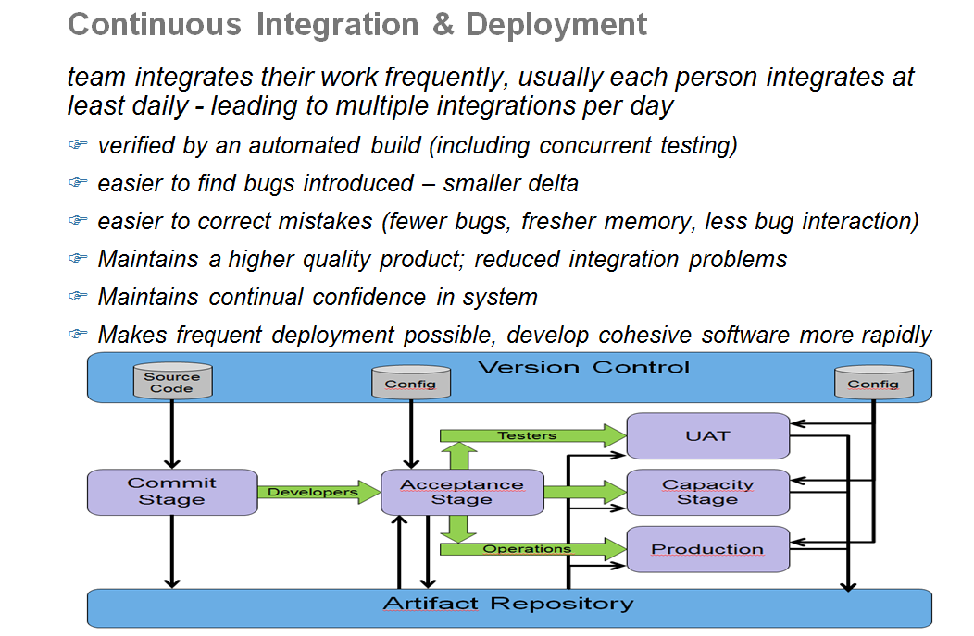

Slide 35
Technology in DevOps
Infrastructure as a Code
Delivery Pipeline
Deployment automation and release management

Slide 36
Infrastructure as a Code
To manage the scale and the speed with which environments need to be provisioned and configured to enable continuous delivery
Deals with capturing node definitions and configurations as code.
Software Defined environments use technologies that define entire systems made up of multiple nodes, which includes their configurations, definitions, topologies, roles, relationships, workloads, work load policies, and behavior.
Application or middleware centric tools
Generic tools

Slide 37
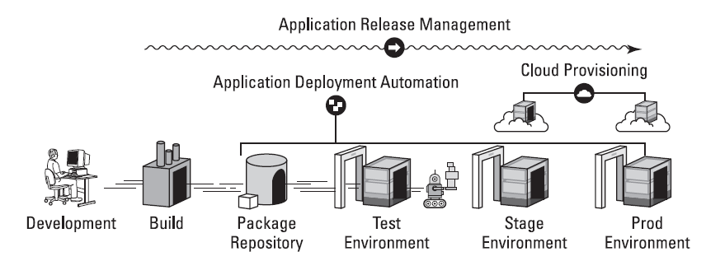
Delivery Pipeline

